Slide 1
Queues and Priority Queues
Chapter 13
© 2017 Pearson Education, Hoboken, NJ. All rights reserved

Slide 2
The ADT Queue
Like a line of people
  First person in line is first person served
  New elements of queue enter at its back
  Items leave the queue from its front
Called FIFO behavior
  First In First Out
© 2017 Pearson Education, Hoboken, NJ. All rights reserved

Slide 3
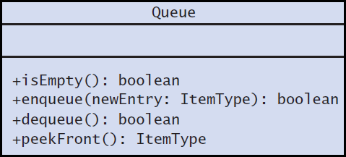
The ADT Queue
FIGURE 13-1 UML diagram for the class Queue
© 2017 Pearson Education, Hoboken, NJ. All rights reserved

Slide 4
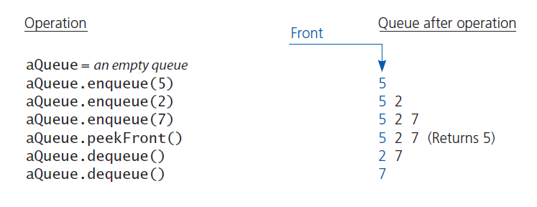
The ADT Queue
FIGURE 13-2 Some queue operations
© 2017 Pearson Education, Hoboken, NJ. All rights reserved

Slide 5
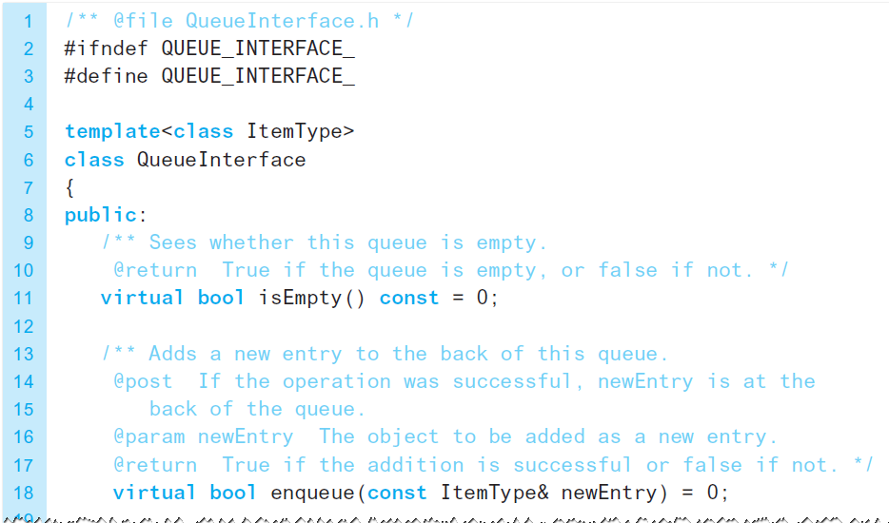
The ADT Queue
LISTING 13-1 A C++ interface for queues
© 2017 Pearson Education, Hoboken, NJ. All rights reserved

Slide 6
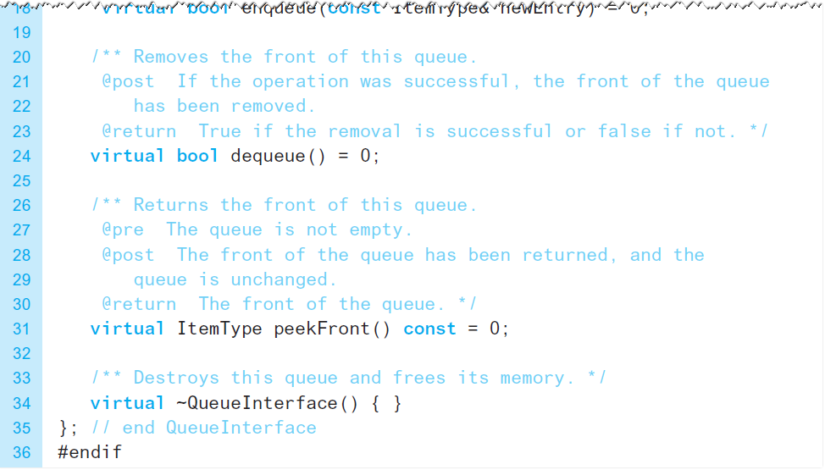
The ADT Queue
LISTING 13-1 A C++ interface for queues
© 2017 Pearson Education, Hoboken, NJ. All rights reserved

Slide 7
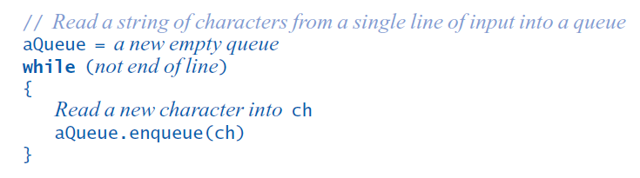
Applications
Reading a String of Characters
Pseudocode to read a string of characters into a queue.
© 2017 Pearson Education, Hoboken, NJ. All rights reserved

Slide 8
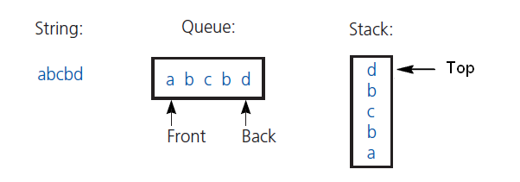
Applications
Recognizing a Palindrome
FIGURE 13-3 The results of inserting the characters a, b, c, b, d into both a queue and a stack
Remove characters from front of queue, top of stack
Compare each pair removed
If all pairs match, string is a palindrome
© 2017 Pearson Education, Hoboken, NJ. All rights reserved

Slide 9
The ADT Priority Queue
Organize data by priorities
  Example: weekly “to do” list
Priority value
  We will say high value ⇨ high priority
Operations
  Test for empty
  Add to queue in sorted position
  Remove/get entry with highest priority
© 2017 Pearson Education, Hoboken, NJ. All rights reserved

Slide 10
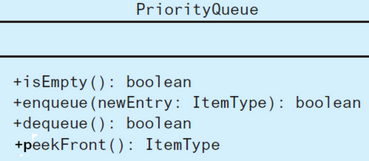
The ADT Priority Queue
FIGURE 13-4 UML diagram for the class PriorityQueue
© 2017 Pearson Education, Hoboken, NJ. All rights reserved

Slide 11
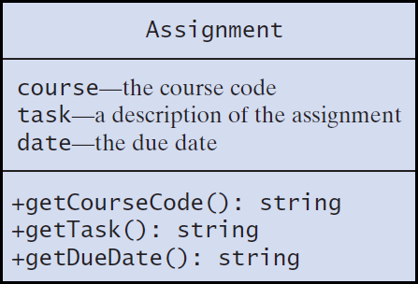
Tracking Your Assignments
FIGURE 13-5 UML diagram for the class Assignment
© 2017 Pearson Education, Hoboken, NJ. All rights reserved

Slide 12
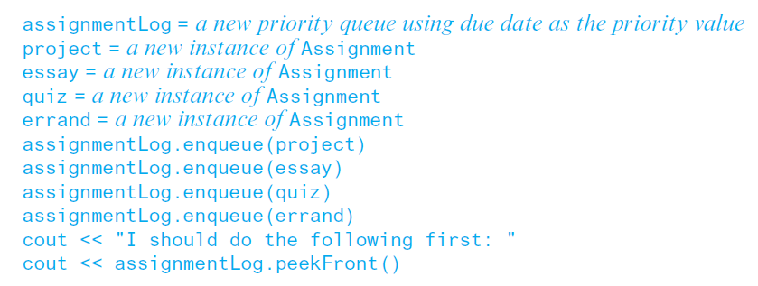
Tracking Your Assignments
Pseudocode to organize assignments, responsibilities
© 2017 Pearson Education, Hoboken, NJ. All rights reserved

Slide 13
Application: Simulation
Simulation models behavior of systems
Problem to solve
  Approximate average time bank customer must wait for service from a teller
  Decrease in customer wait time with each new teller added
© 2017 Pearson Education, Hoboken, NJ. All rights reserved

Slide 14
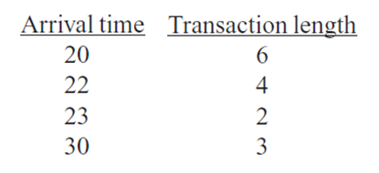
Application: Simulation
Sample arrival and transaction times
© 2017 Pearson Education, Hoboken, NJ. All rights reserved

Slide 15
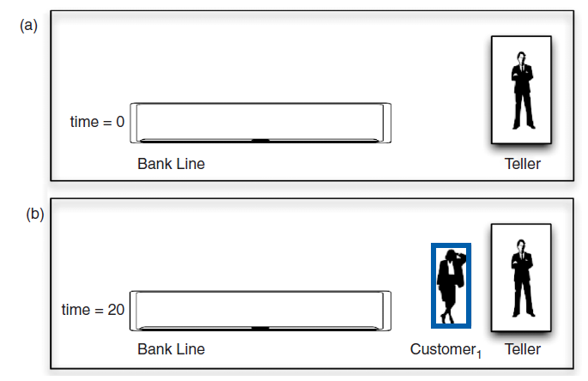
Application: Simulation
FIGURE 13-6 A bank line at time (a) 0; (b) 20; (c) 22; (d) 26
© 2017 Pearson Education, Hoboken, NJ. All rights reserved

Slide 16
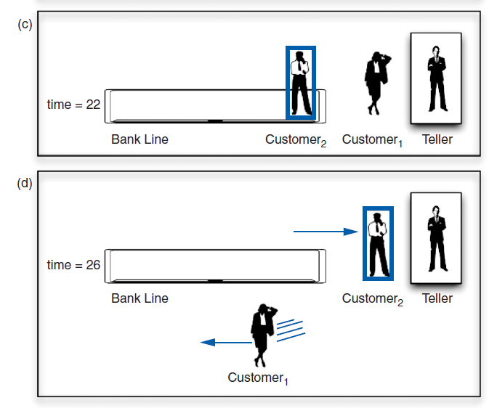
Application: Simulation
FIGURE 13-6 A bank line at time (a) 0; (b) 20; (c) 22; (d) 26
© 2017 Pearson Education, Hoboken, NJ. All rights reserved

Slide 17
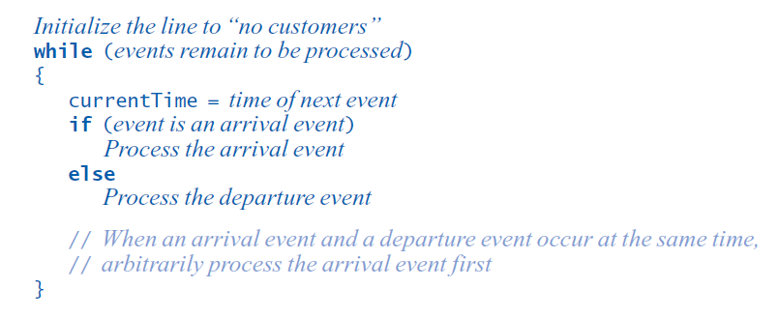
Application: Simulation
Pseudocode for an event loop
© 2017 Pearson Education, Hoboken, NJ. All rights reserved

Slide 18
Application: Simulation
Time-driven simulation
  Simulates the ticking of a clock
Event-driven simulation considers
  Only the times of certain events,
  In this case, arrival-s and departures
Event list contains
  All future arrival and departure events
© 2017 Pearson Education, Hoboken, NJ. All rights reserved

Slide 19
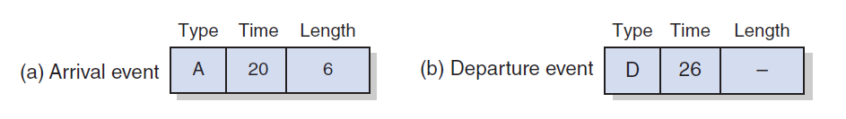
Application: Simulation
FIGURE 13-7 A typical instance of (a) an arrival event;
(b) a departure event
© 2017 Pearson Education, Hoboken, NJ. All rights reserved

Slide 20
Application: Simulation
Two tasks required to process each event
  Update the bank line: Add or remove customers.
  Update the event queue: Add or remove events.
New customer
  Always enters bank line
  Served while at the front of the line
© 2017 Pearson Education, Hoboken, NJ. All rights reserved

Slide 21
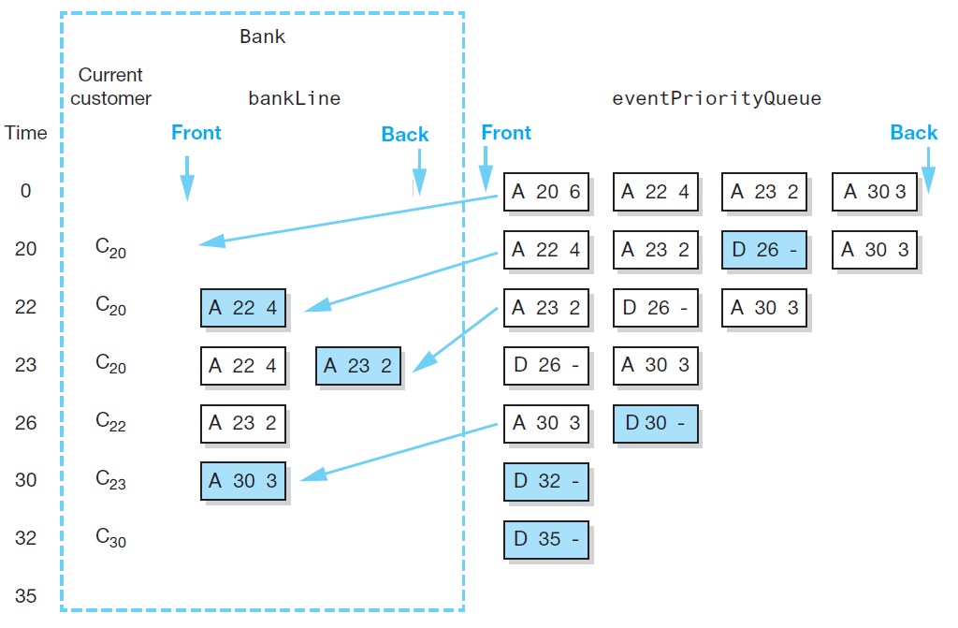
Application: Simulation
FIGURE 13-8 A trace of the bank simulation algorithm for the data (20, 6), (22, 4), (23, 2), (30, 3)
© 2017 Pearson Education, Hoboken, NJ. All rights reserved

Slide 22
Position-Oriented and
Value-Oriented ADTs
Position-oriented ATDs
  Stack, list, queue
Value-oriented ADTs
  Sorted list
© 2017 Pearson Education, Hoboken, NJ. All rights reserved

Slide 23
Position-Oriented and
Value-Oriented ADTs
Comparison of stack and queue operations
  isEmpty for both
  pop and dequeue
  peek and peekFront
© 2017 Pearson Education, Hoboken, NJ. All rights reserved

Slide 24
Position-Oriented and
Value-Oriented ADTs
ADT list operations generalize stack and queue operations
  getLength
  insert
  remove
  getEntry
© 2017 Pearson Education, Hoboken, NJ. All rights reserved

Slide 25
End
Chapter 13
© 2017 Pearson Education, Hoboken, NJ. All rights reserved

